Slide 1



DEA Group Assignment
A.S. Hendawitharana
C.R Wedage
S.T. Kumasaru
R.M.A. Pramodya
U.B.M.H.E.M. Balasuriya
C.M.D.N. Senavirathne
Phoenix Airlines PVT Ltd.

Slide 2


Slide 3


Slide 4
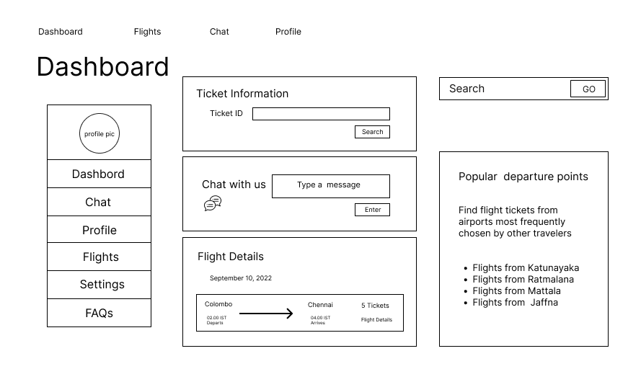

Slide 5
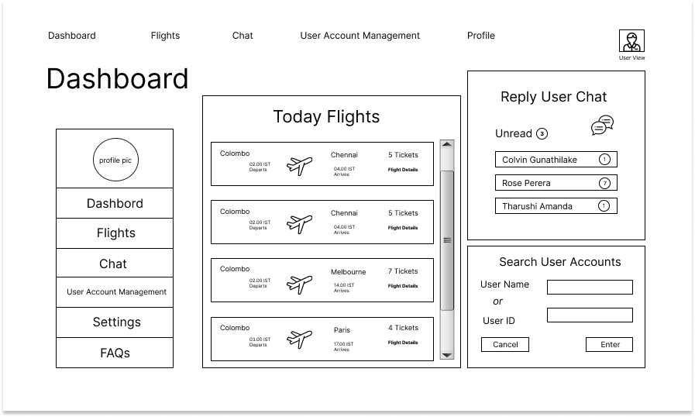

Slide 6
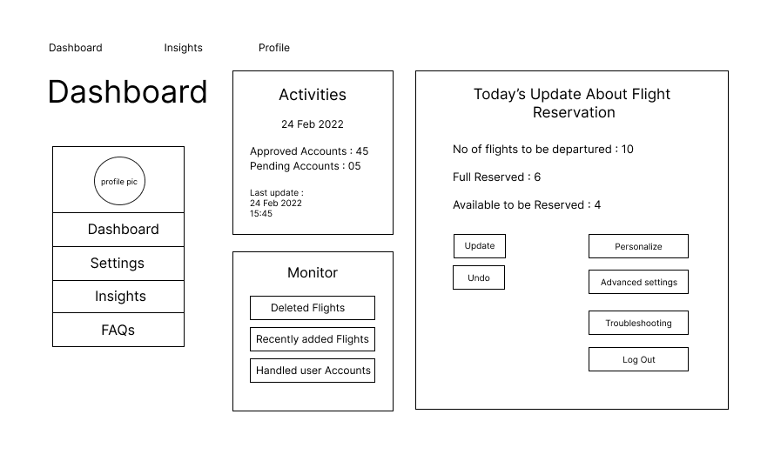

Slide 7
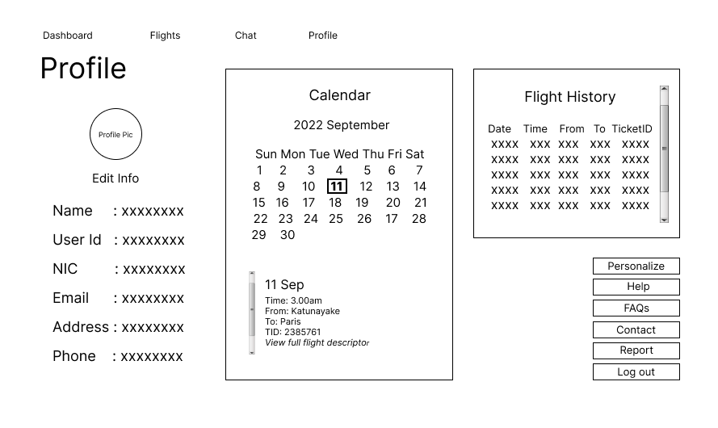

Slide 8
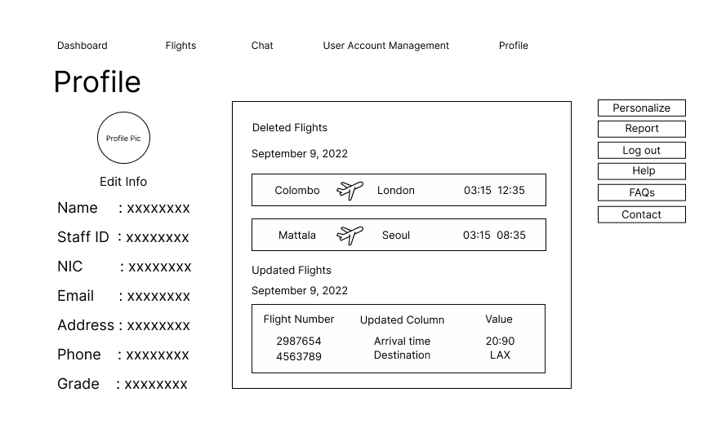

Slide 9
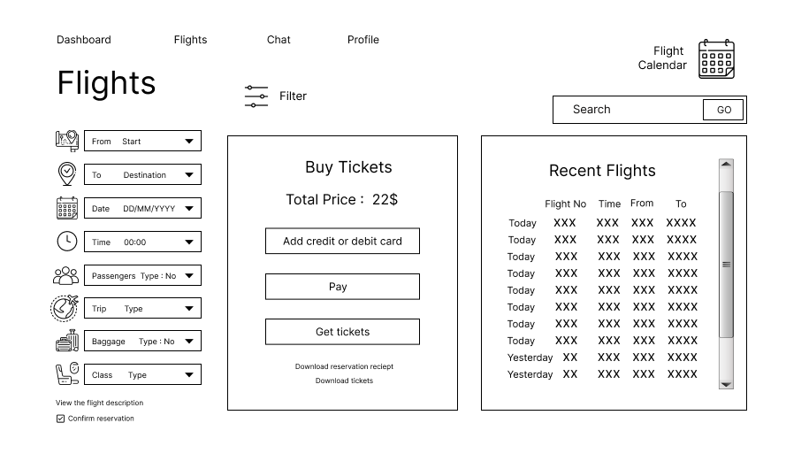

Slide 10
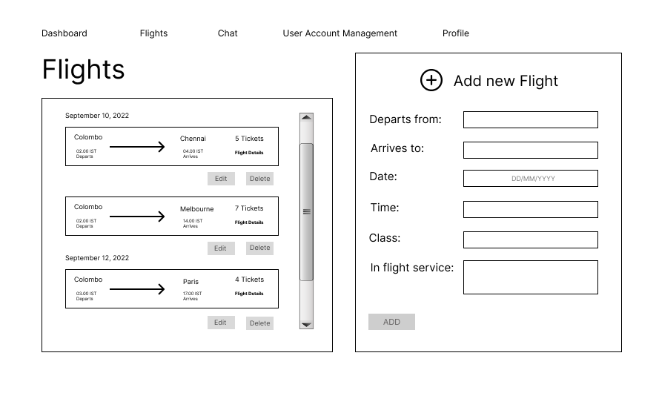

Slide 11
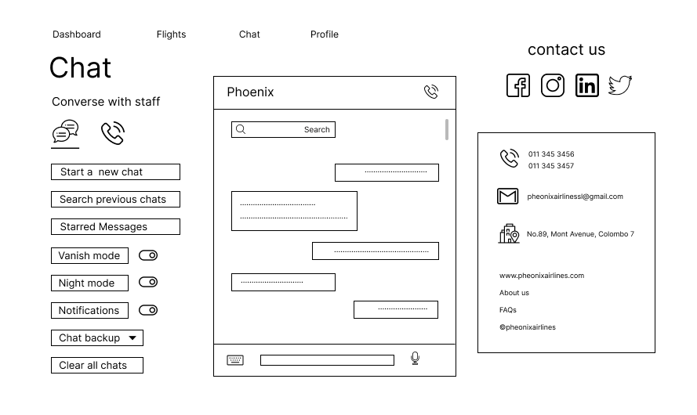

Slide 12
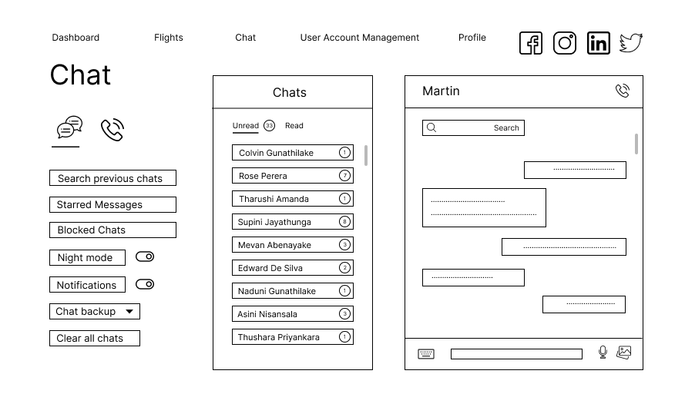

Slide 13
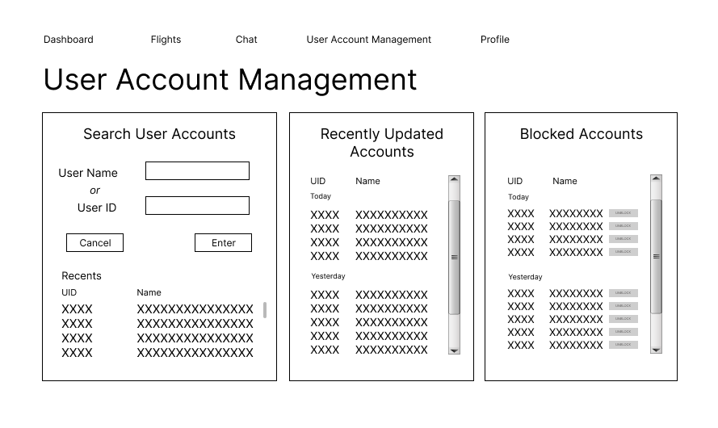

Slide 14
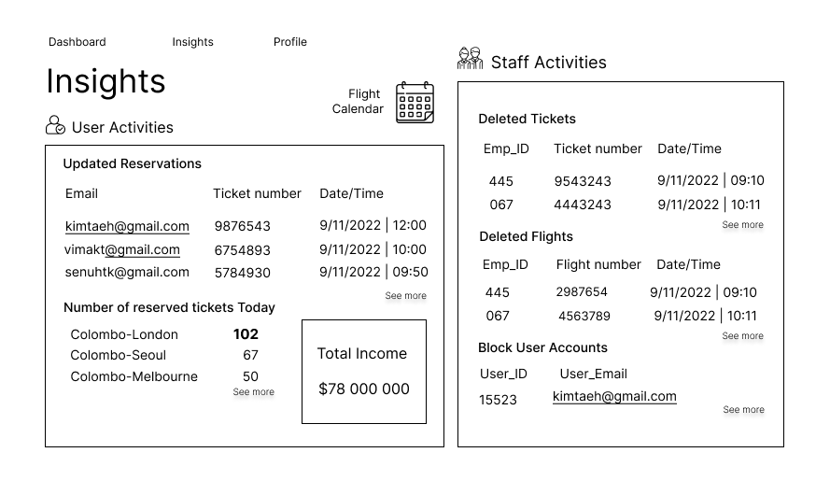

Slide 15
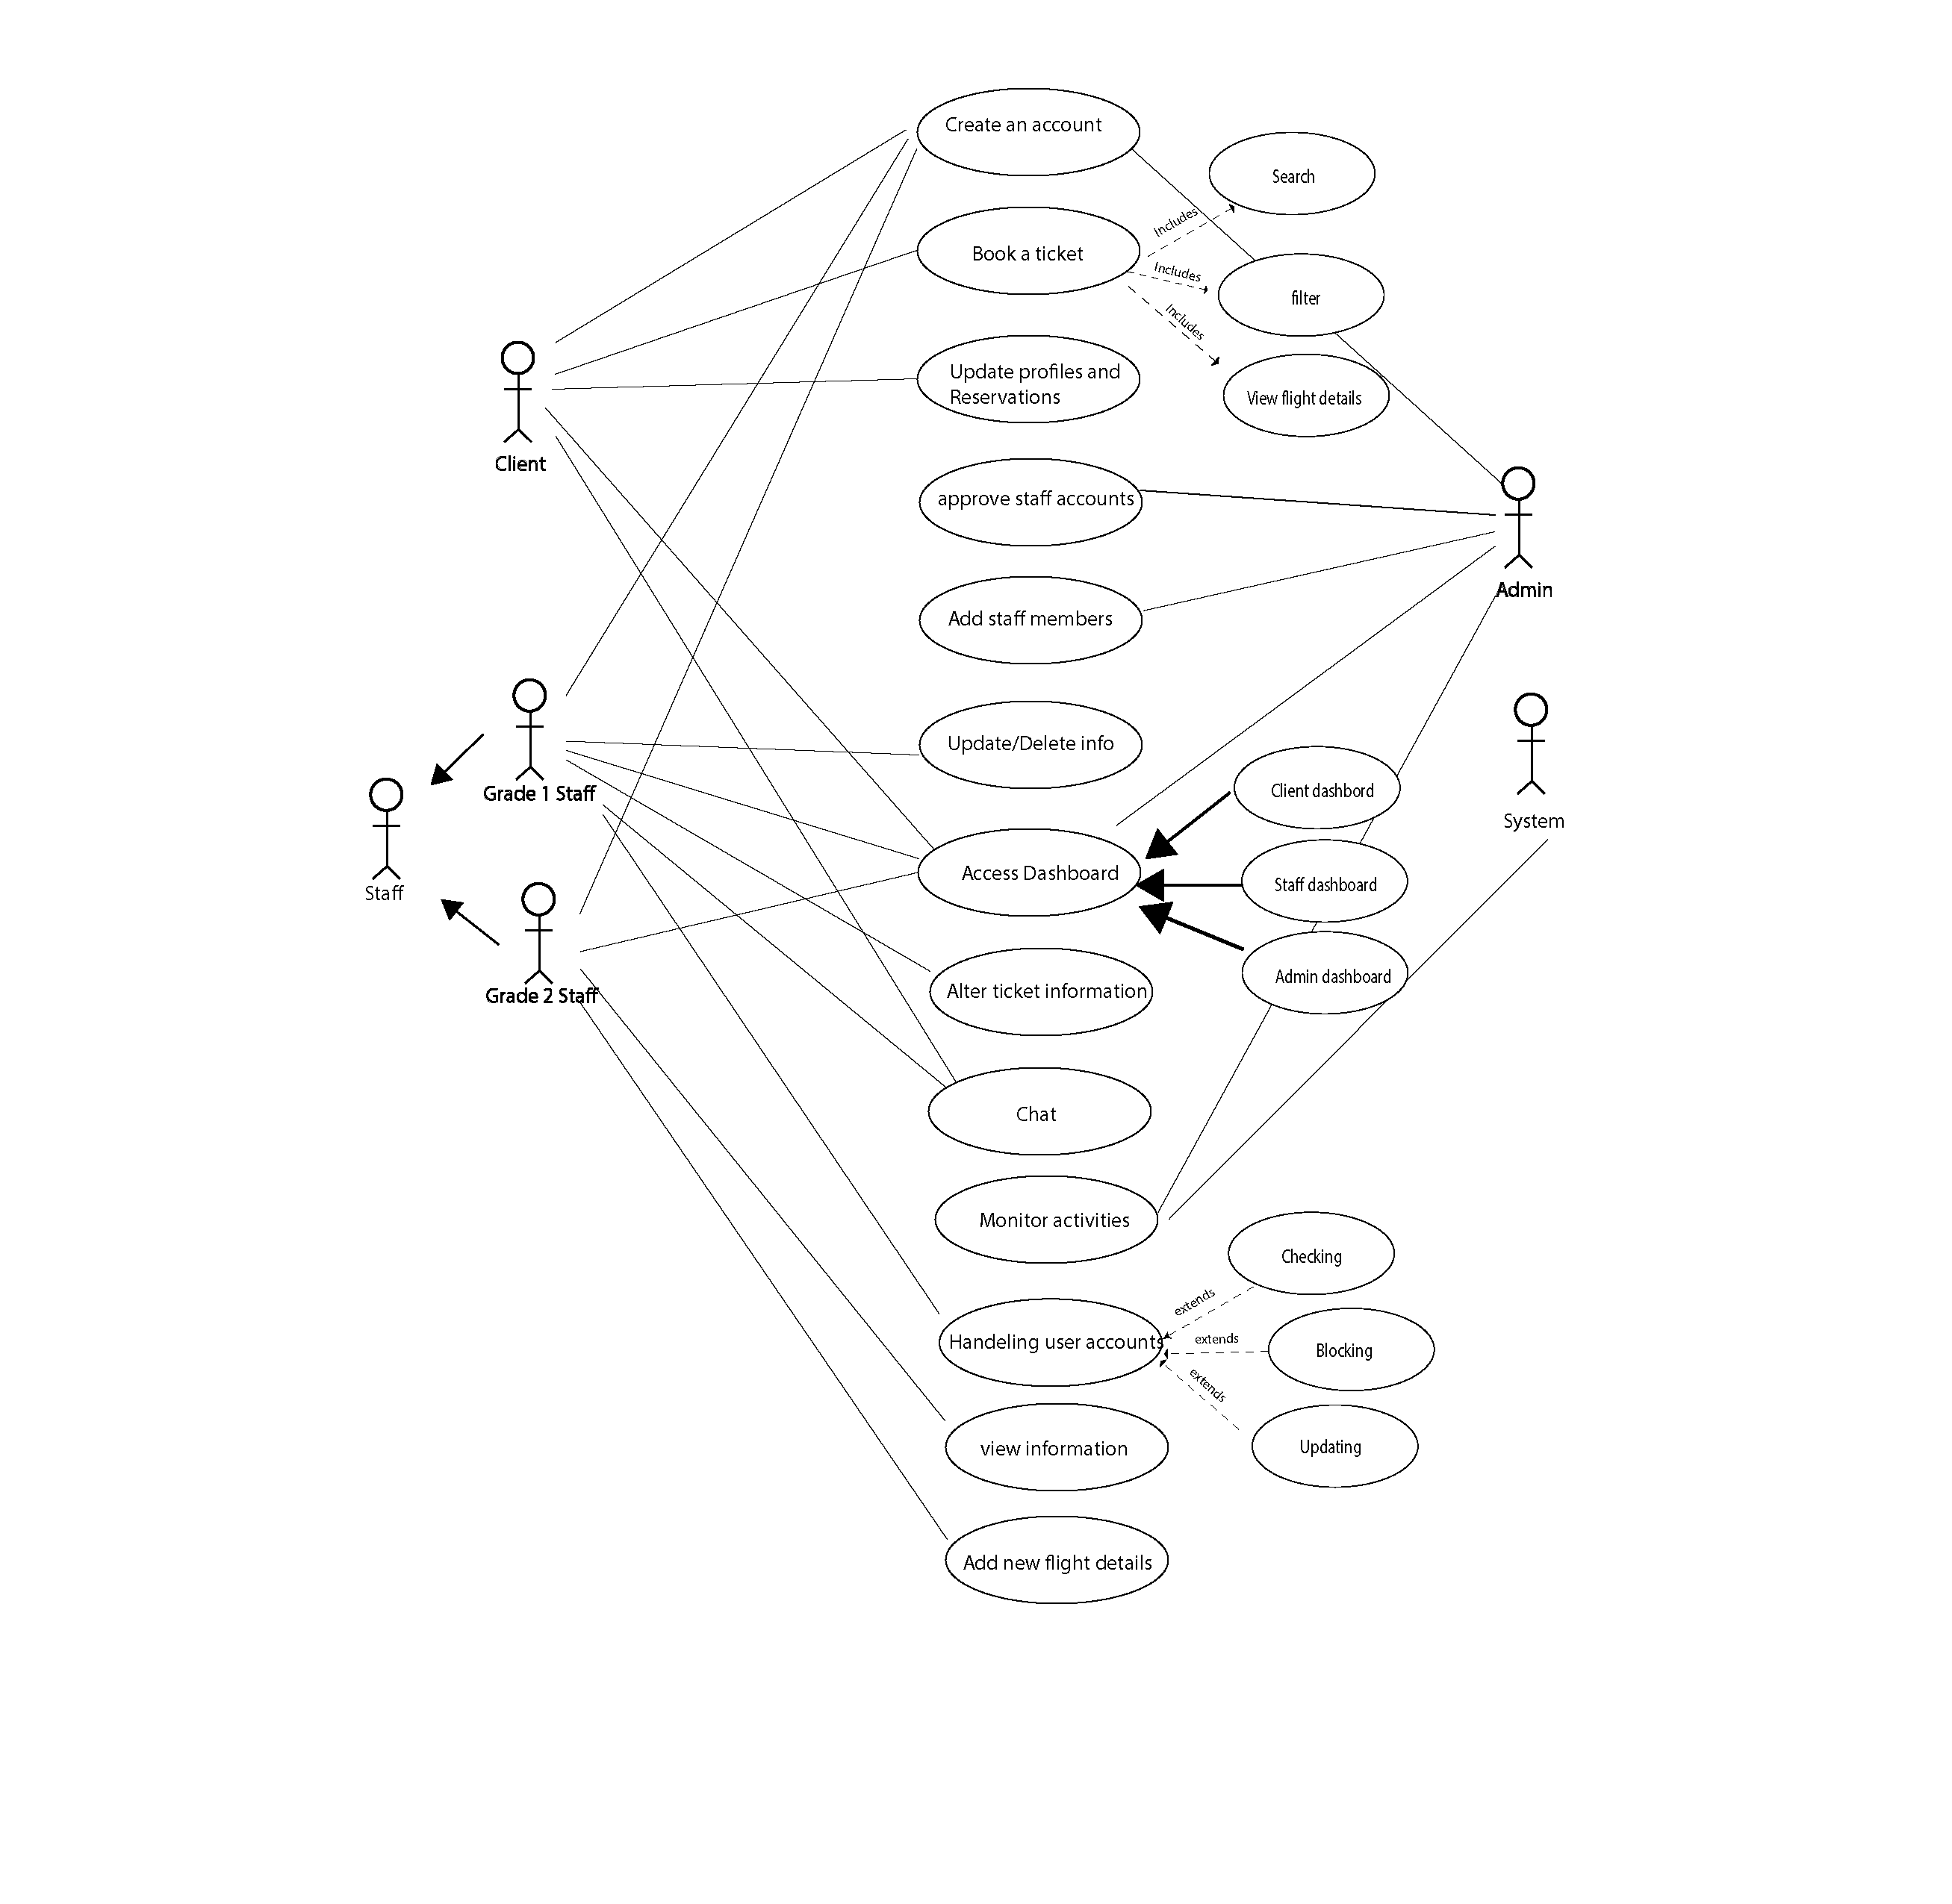

Slide 16
Thank You

